Slide 1
Internet of Things + PuckJS session
Innovation Office
May 2017

Slide 2
Outline
Introduction to Disruptive Innovation
Internet of things (IoT)
Puck JS
Hands on

Slide 3
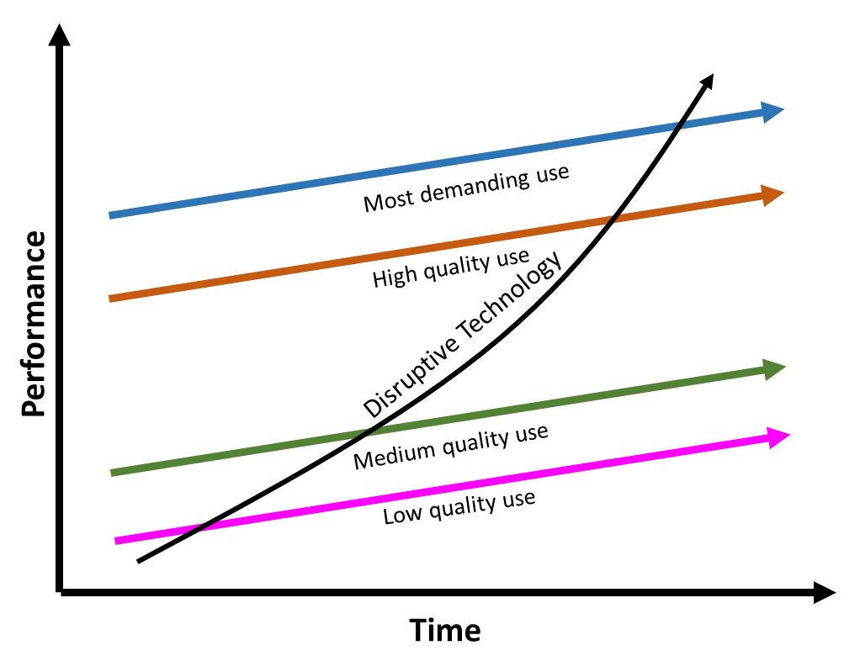

Theory of Disruptive Innovation
Sustaining Innovation. These focus on growing existing technologies by enhancing their performance, mostly through extended functionality or increased capacity.
VS
Disruptive Innovation. These change the landscape of an entire industry, or spark a new one altogether, because they solve a problem in an entirely new way or for an entirely new group of people.
Clayton Christensen

Slide 4
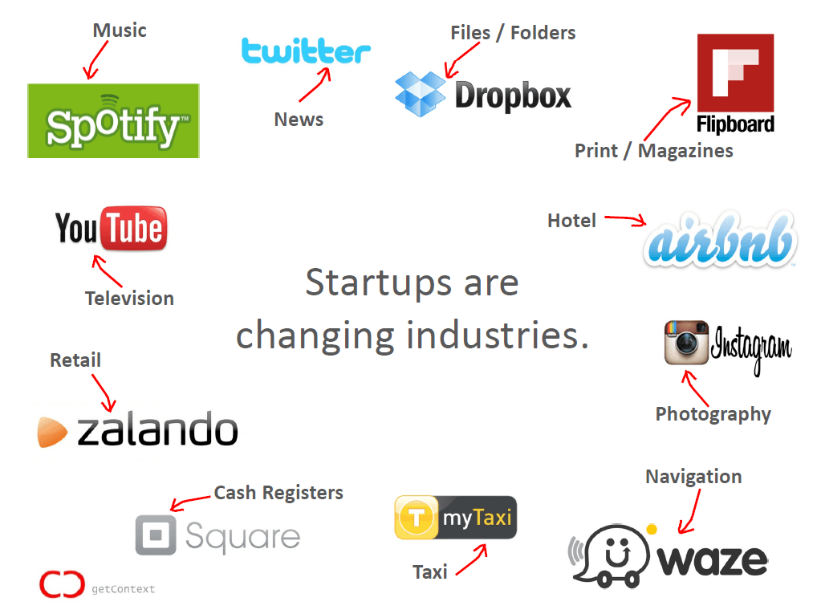
Disrupted Industries
Who’s next?

Slide 5
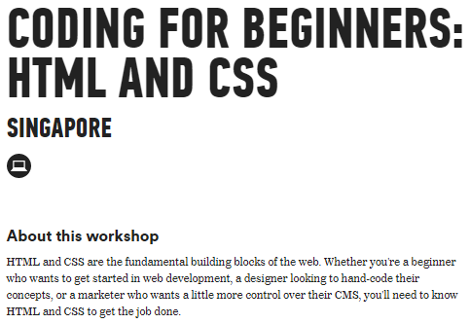

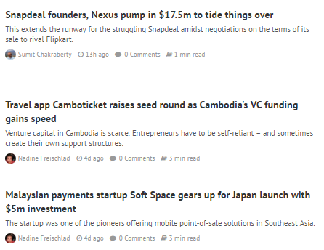
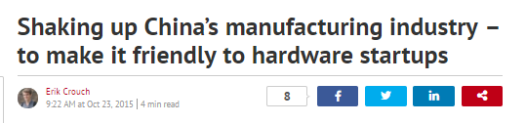
Why are industries disrupted so quickly?
Tech literacy
Low/no barriers to entry
Low manufacturing cost
Venture funding in hopes of unicorns ($1B startups)

Slide 6
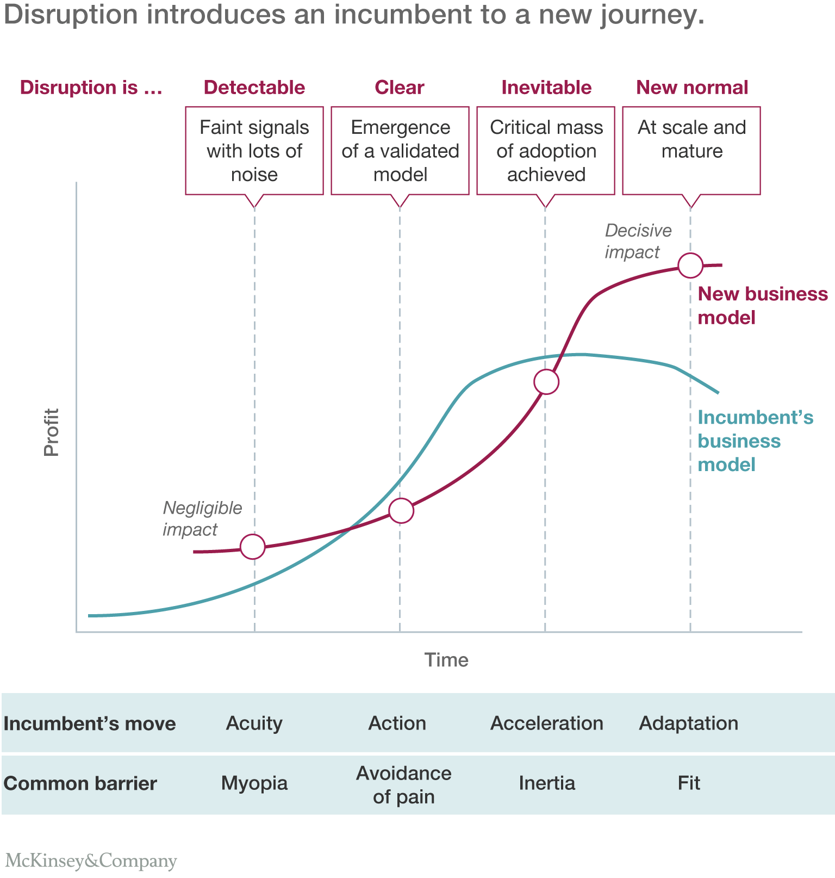
The incumbent’s journey of disruption
http://www.mckinsey.com/business-functions/strategy-and-corporate-finance/our-insights/an-incumbents-guide-to-digital-disruption

Slide 7
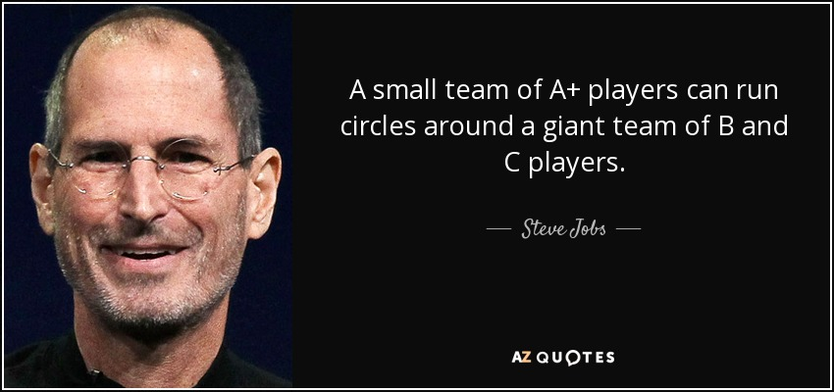
What can we do?
Think like a disruptor, act like a startup (PwC)
Embrace change (McKinsey)
Think MVP: Iterate quickly (Peter Thiel)

Slide 8
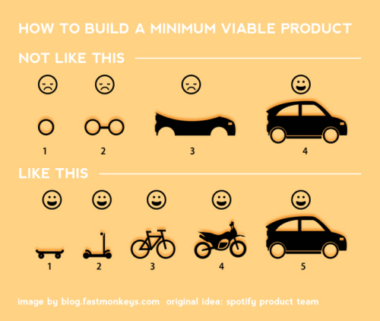
Think MVP: Minimum Viable Product

Slide 9
Learning Outcomes
Think like a disruptor
Think MVPs (Minimum Viable Product)

